Slide 1


Designing the controller of a Vertical take off and landing aircraft (VTOL)
MohammadMahdi Malverdi,Danesh Abodollahi,Sajjad Ghadiri,Mohammad Barabadi
Amirkabir University of Technology (Tehran Polytechnic)

Slide 2
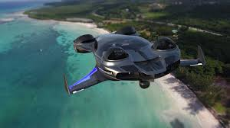
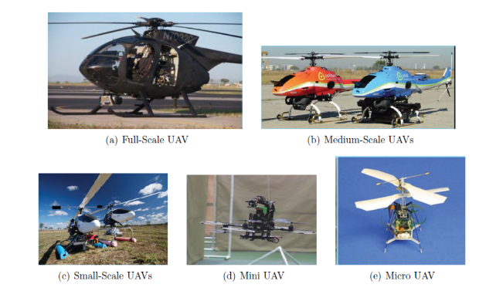
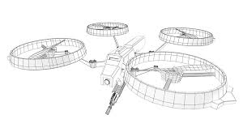
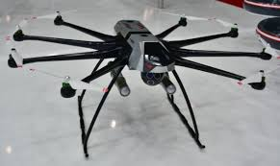
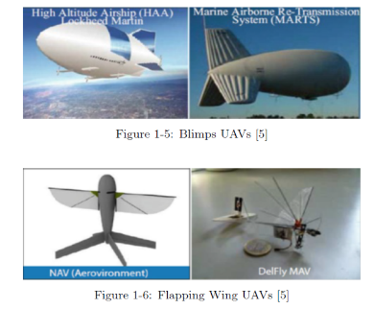
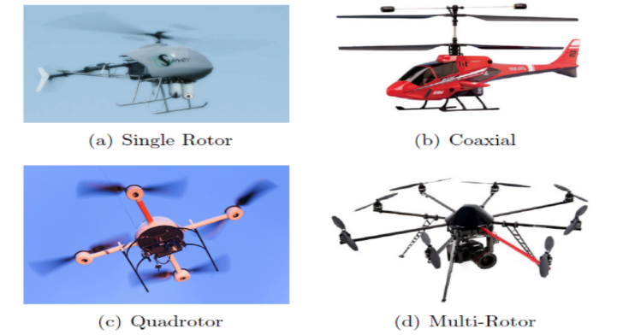
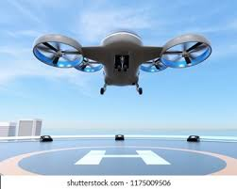
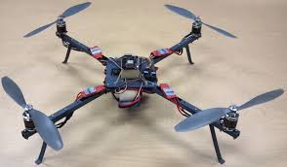
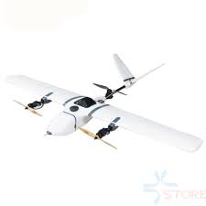
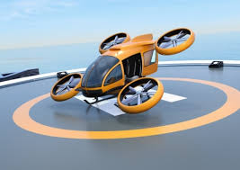
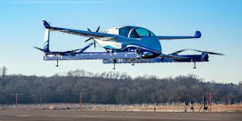
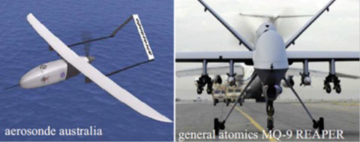
What is a VTOL and what kinds are they ?

Slide 3
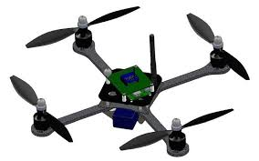
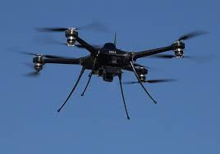
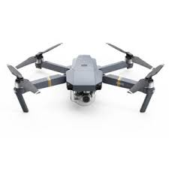
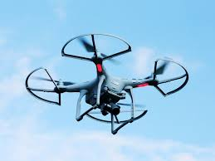
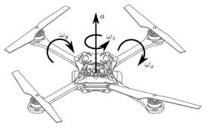
Why Quadrotors?

Slide 4
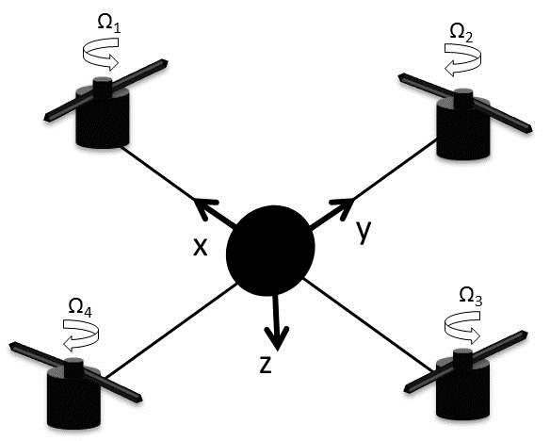
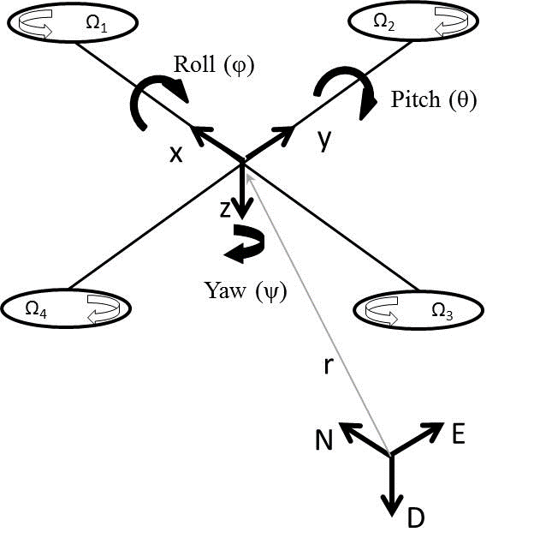
Quadrotors Configurations and Coordinates Analysis

Slide 5
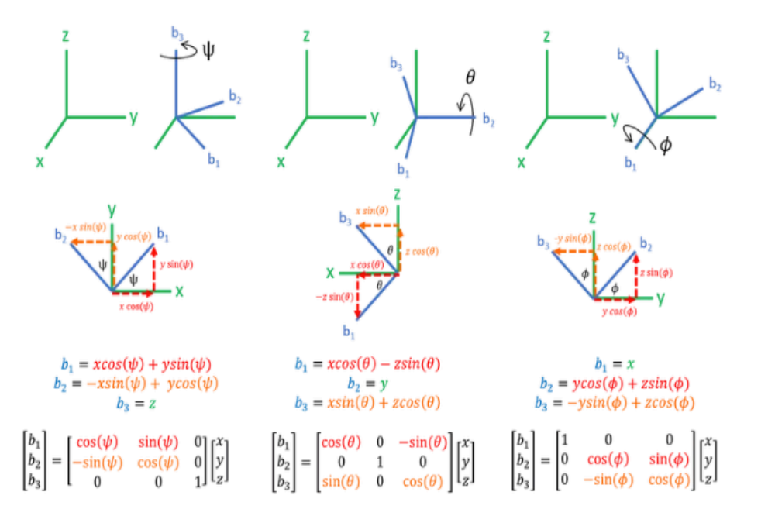
Body Coordinate and Inertial Coordinate

Slide 6
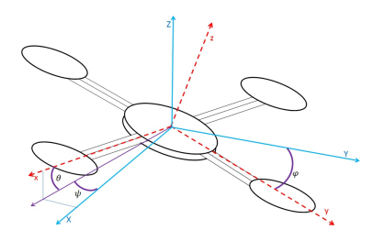
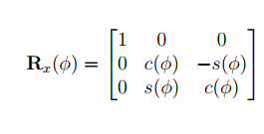
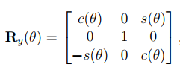
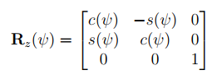
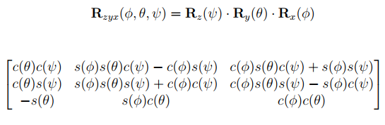
Transformation between Coordinates

Slide 7
Dynamic Equations Assumptions
The quadrotor is a symmetrical rigid body.
The origin of inertial coordinate system is in the same
position with the geometric center and centroid of the
Quadrotor.
Resistance and gravity of the quadrotor are not affected
by flight altitude and other factors.
Tensions in all directions are proportional to the square
of the propeller speed.
The gyroscopic moments are ignored(MG).

Slide 8
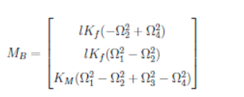
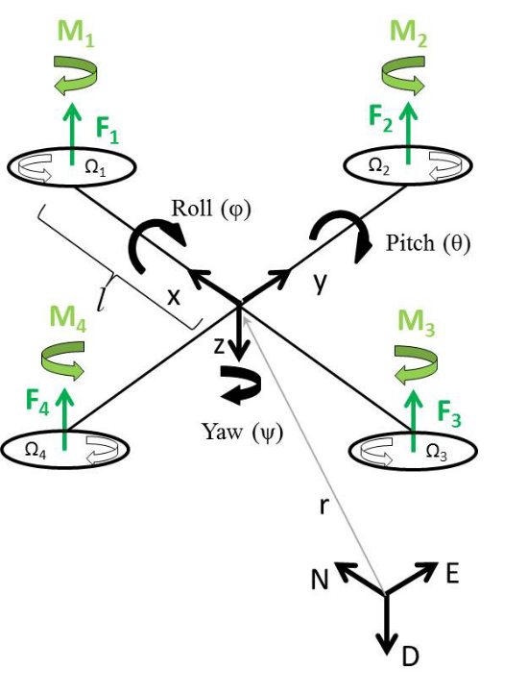
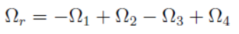
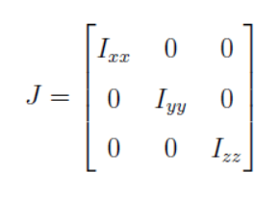
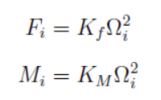
Auxiliary Equations
Inertia Matrix

Slide 9
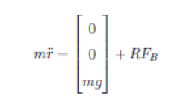
Translational Equations of Motion
r=[x y z]^{T} Quadrotor’s distance from the inertial frame
m Quadrotor’s mass
g gravitational acceleration g=9.81 m/s²
F_{B} non-gravitational forces acting on the quadrotor in the body frame

Slide 10
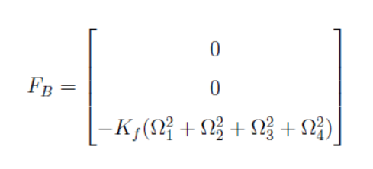
Non-gravitational Forces Acting on the Quadrotor

Slide 11
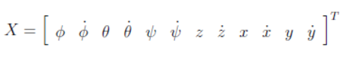
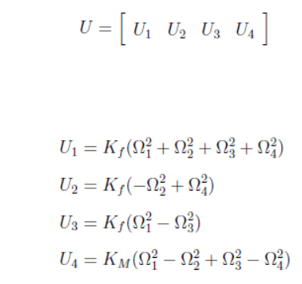
State Space Equations

Slide 12
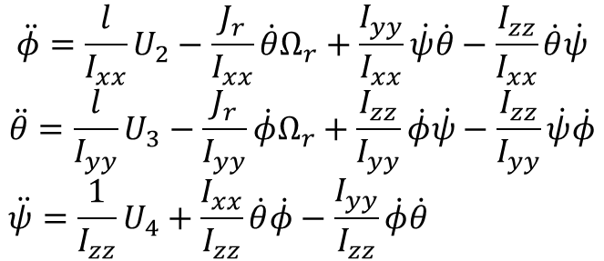
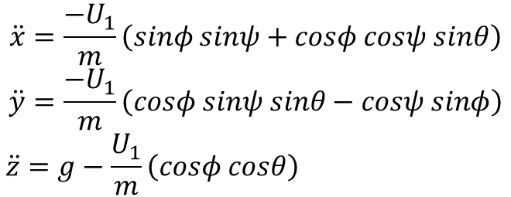
Dynamic Equations
$$\ddot{x}=\frac{−U_{1}}{m}\left(sinφ sinψ+cosφ cosψ sinθ\right)$$
$$\ddot{y}=\frac{−U_{1}}{m}\left(cosφ sinψ sinθ−cosψ sinφ\right)$$
$$\ddot{z}=g−\frac{U_{1}}{m}\left(cosφ cosθ\right)$$
$$\ddot{φ}=\frac{l}{I_{xx}}U_{2}−\frac{J_{r}}{I_{xx}}\dot{θ}Ω_{r}+\frac{I_{yy}}{I_{xx}}\dot{ψ}\dot{θ}−\frac{I_{zz}}{I_{xx}}\dot{θ}\dot{ψ}$$
$$\ddot{θ}=\frac{l}{I_{yy}}U_{3}−\frac{J_{r}}{I_{yy}}\dot{φ}Ω_{r}+\frac{I_{zz}}{I_{yy}}\dot{φ}\dot{ψ}−\frac{I_{zz}}{I_{yy}}\dot{ψ}\dot{φ}$$
$$\ddot{ψ}=\frac{1}{I_{zz}}U_{4}+\frac{I_{xx}}{I_{zz}}\dot{θ}\dot{φ}−\frac{I_{yy}}{I_{zz}}\dot{φ}\dot{θ}$$

Slide 13
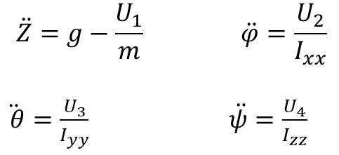
Linearization
Two Ways:
Linearization Feedback
Normal Linearization
$$\ddot{Z}=g−\frac{U_{1}}{m} \ddot{φ}=\frac{U_{2}}{I_{xx}}$$
$\ddot{ θ}=\frac{U_{3}}{I_{yy}}$ $\ddot{ψ}=\frac{U_{4}}{I_{zz}}$

Slide 14
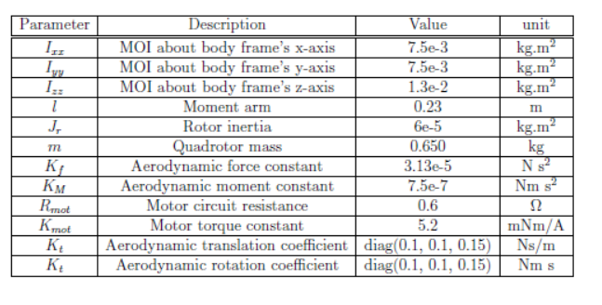
Quadrotor Parameters and Constants

Slide 15
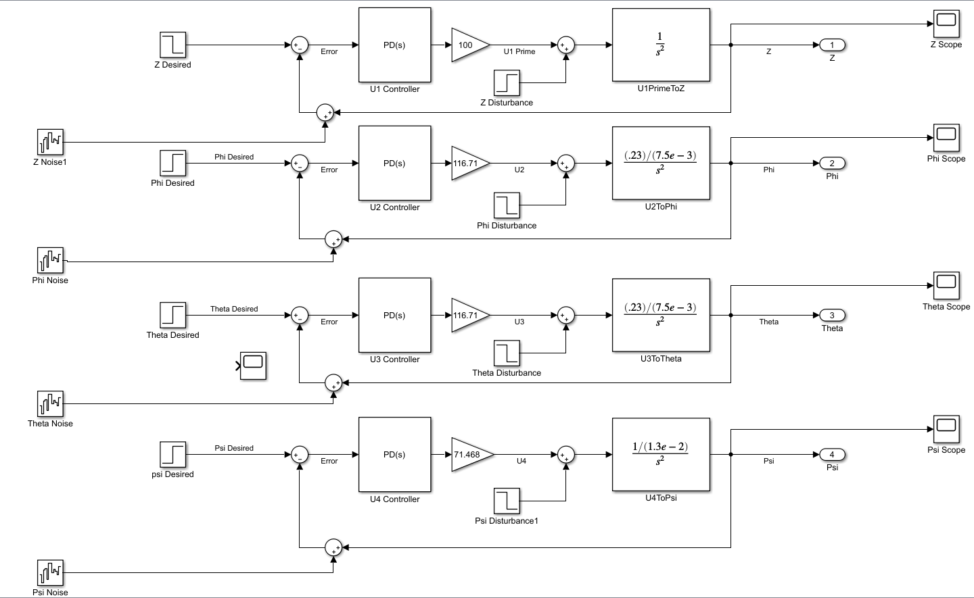
Block diagram

Slide 16
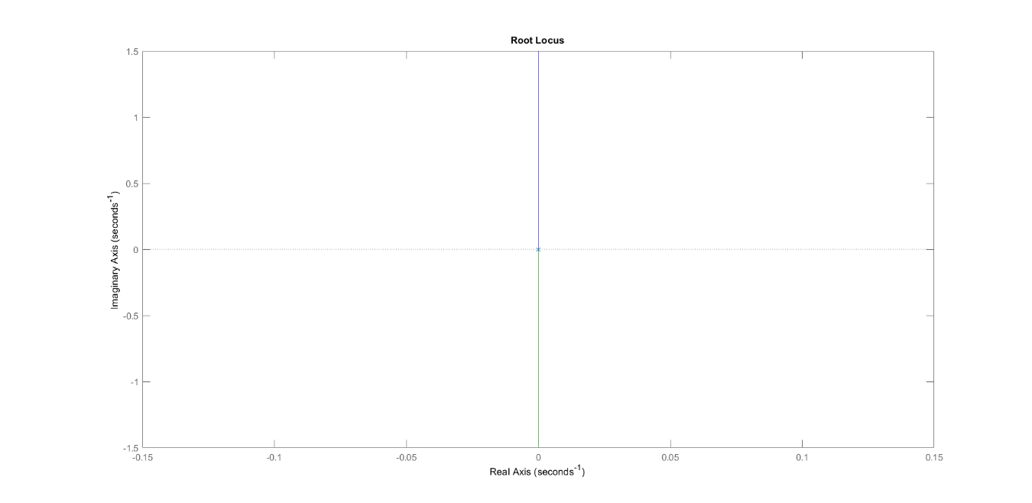
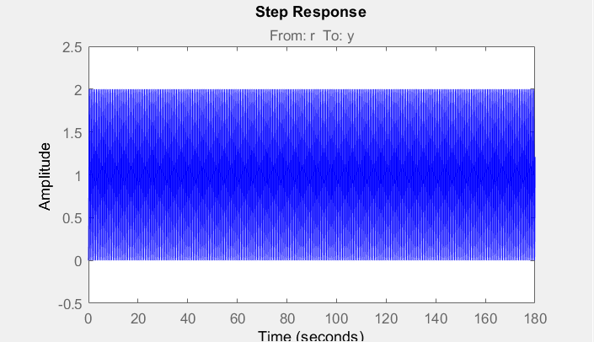
PID PSI Tuning

Slide 17
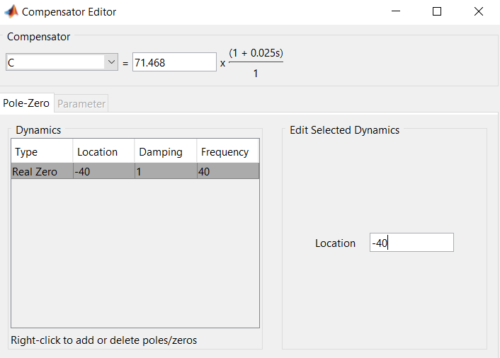
PID PSI Tuning

Slide 18
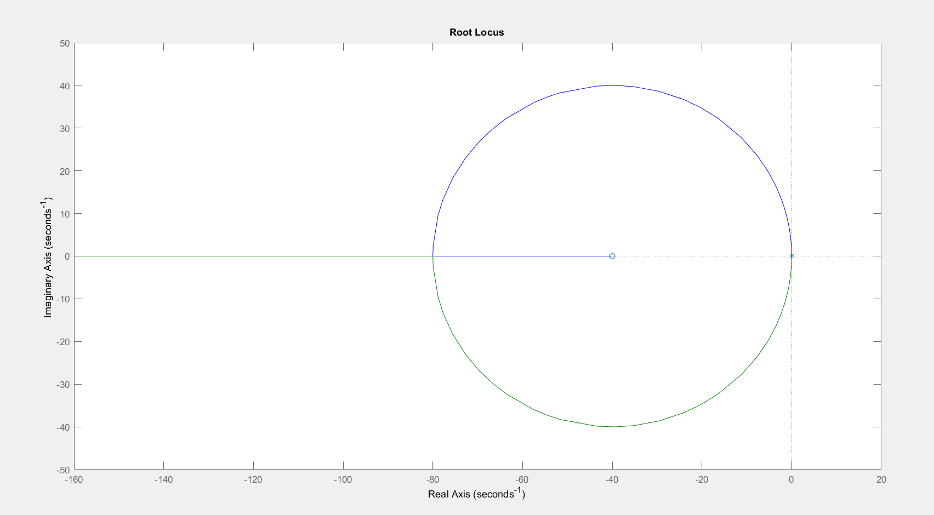
PID PSI Tuning
Root Locus

Slide 19
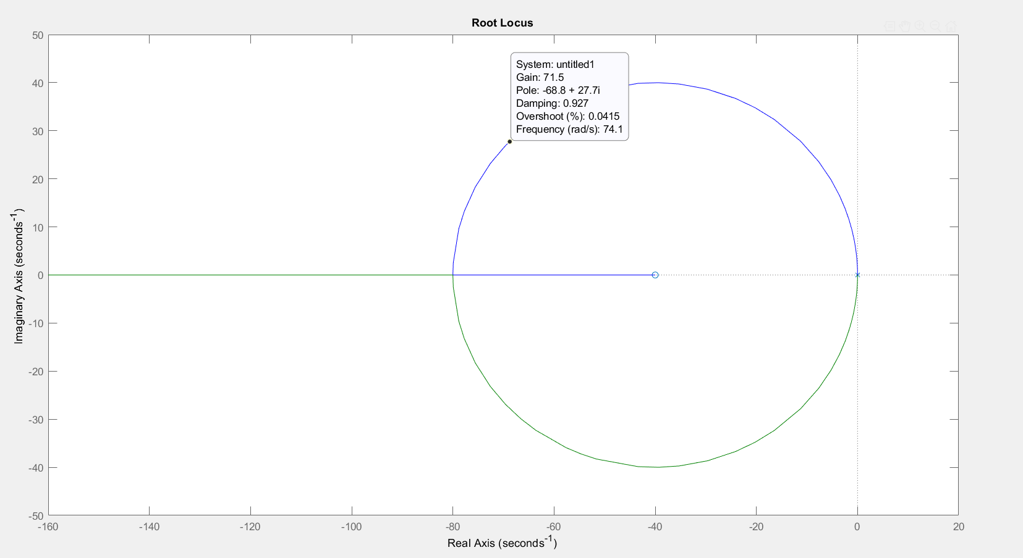
Root Locus Details

Slide 20
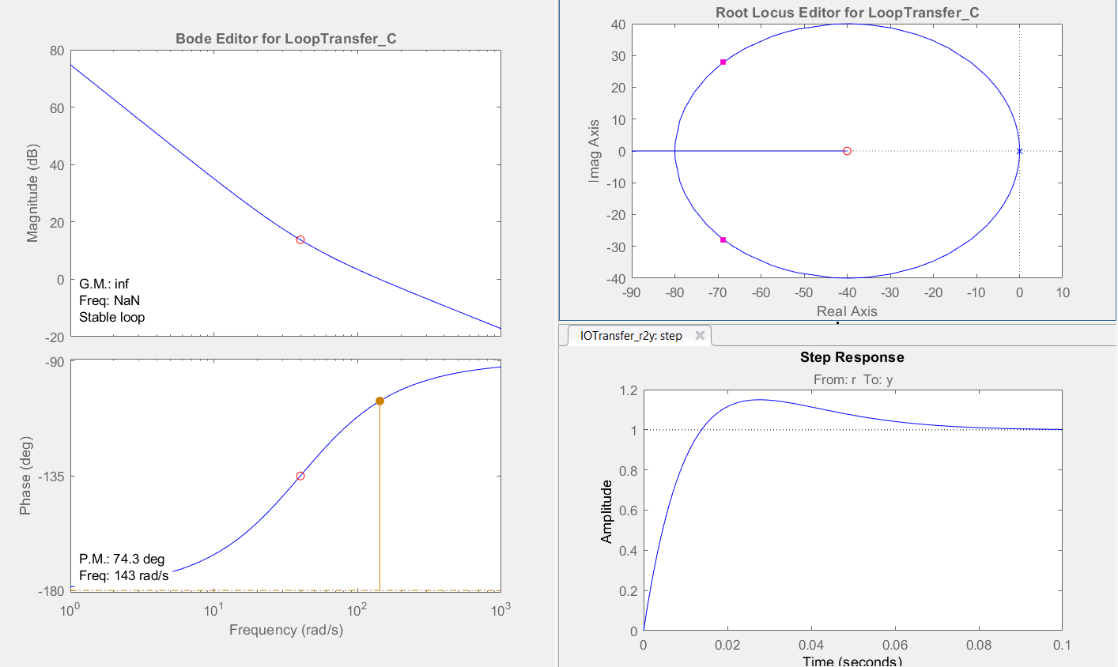
PID PSI Tuning
All plots

Slide 21
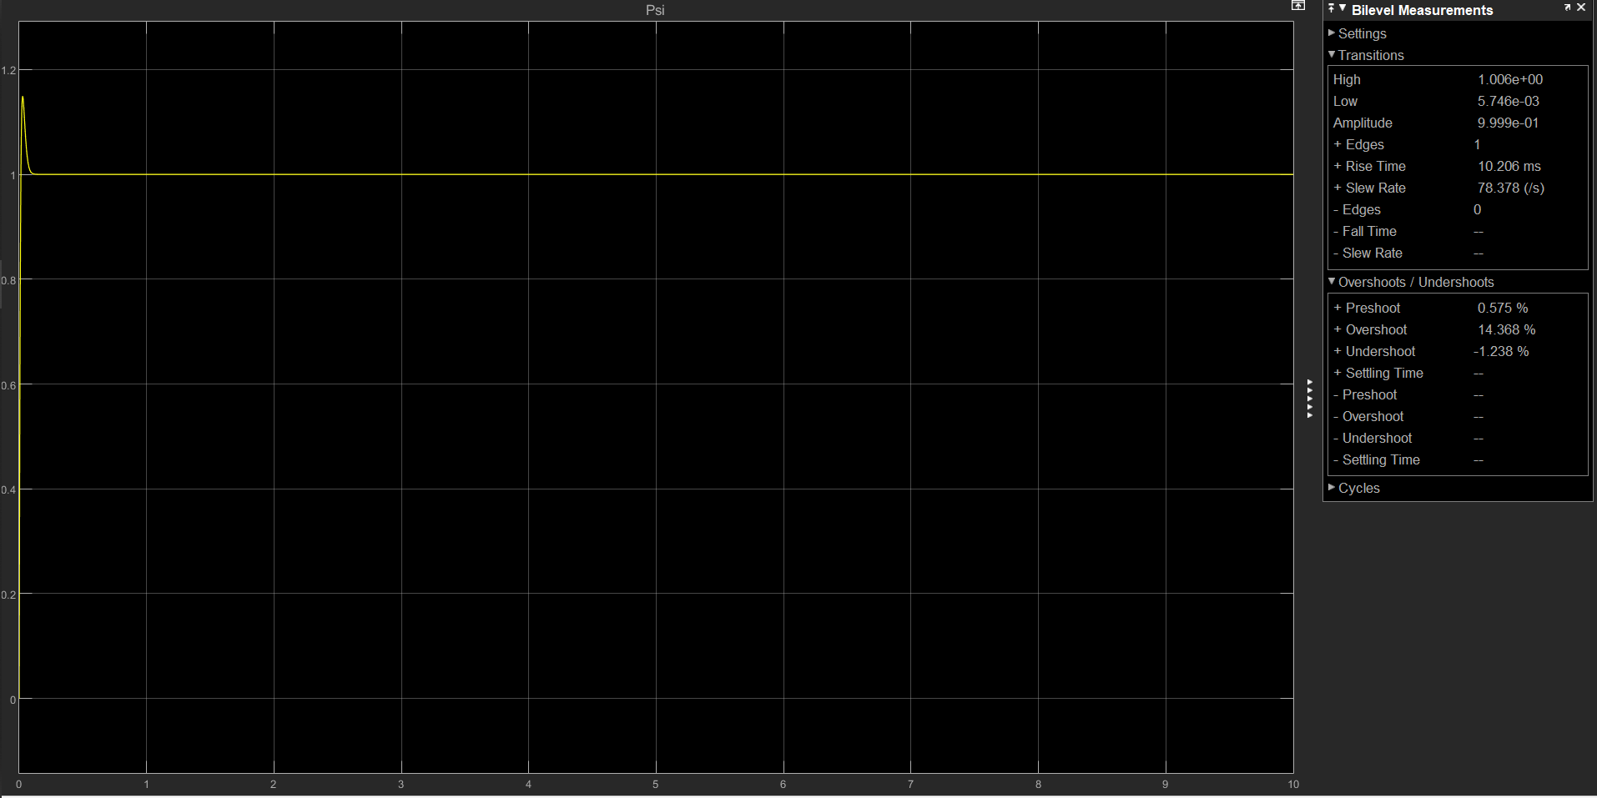
PID PSI Tuning

Slide 22
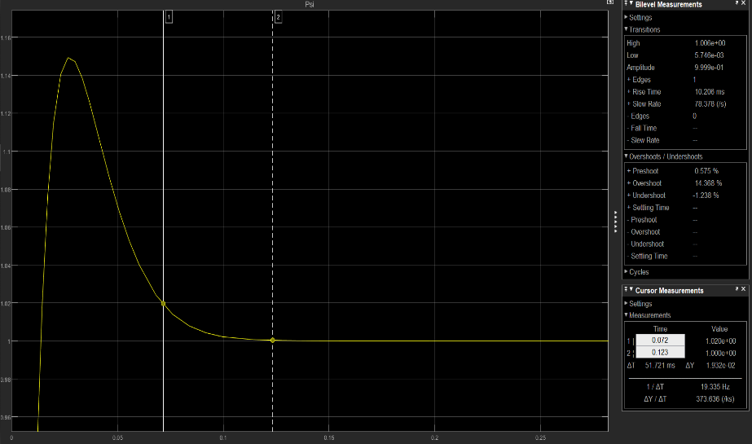
PID PSI Tuning
Scope Detail

Slide 23
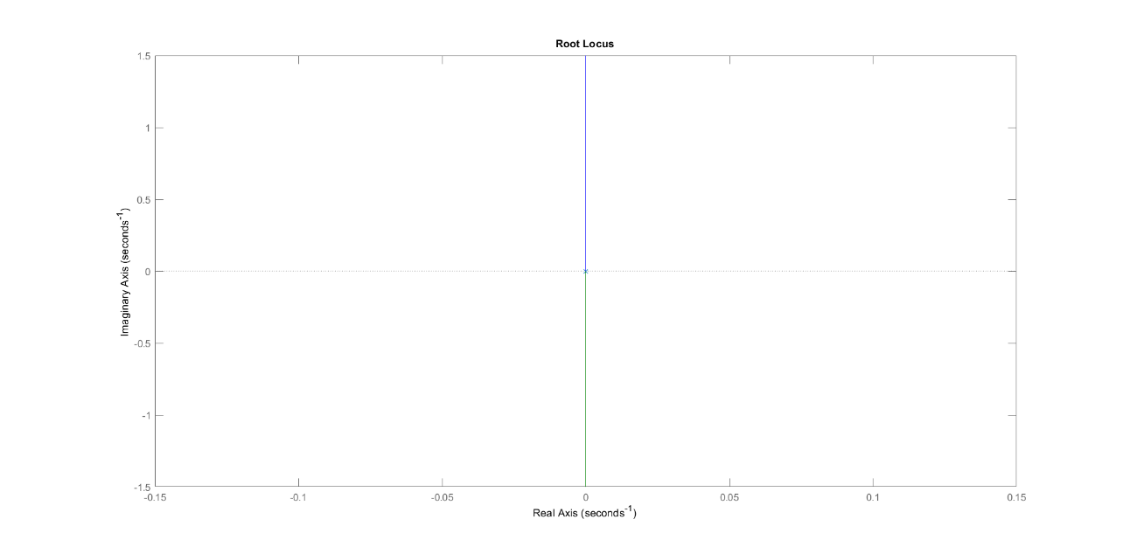
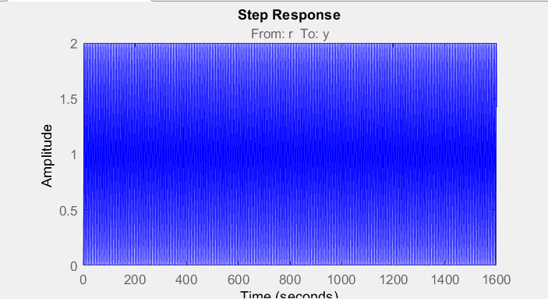
PID Tuning For Z
Step Response
For Untuned
System

Slide 24
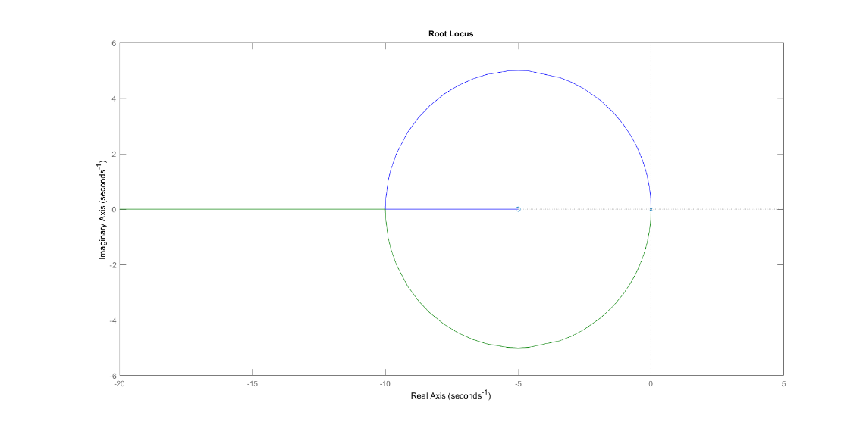
PID Tuning For Z
Rlocus For CG

Slide 25

PID Tuning For Z
Rlocus For CG With Gain

Slide 26

PID Tuning For Z
Tuned

Slide 27

PID Tuning For Z
Tuned Step Response

Slide 28

PID Tuning For Z
Zoom In Tuned Step Response

Slide 29

PID Tuning For Z
Settling Time

Slide 30


PID Tuning For Phi & Theta
Rlocus for G
Step Response
For System
Without PID

Slide 31

PID Tuning For Phi & Theta
Rlocus For CG

Slide 32

PID Tuning For Phi & Theta
Rlocus For CG With Gain

Slide 33

PID Tuning For Phi & Theta
Tuned Step Response

Slide 34

PID Tuning For Phi & Theta
Zoom In Step Response

Slide 35

PID Tuning For Phi & Theta
Settling Time

Slide 36

PID Tuning For Phi & Theta
Tuned

Slide 37
Block Diagrams

Slide 38

Disturbance Effect On Phi & Theta

Slide 39

Disturbance Effect On Phi & Theta
Settling time

Slide 40

Disturbance Effect On Phi & Theta
SS Error

Slide 41

Disturbance Effect On Phi & Theta
Zoom In

Slide 42

Disturbance Effect On Psi
Scope

Slide 43

Disturbance Effect On Psi
Settling Time

Slide 44

Disturbance Effect On Psi
SS Error

Slide 45

Disturbance Effect On Psi
Zoom in

Slide 46

Disturbance Effect On Z
scope

Slide 47

Disturbance Effect On Z
Settling time

Slide 48

Disturbance Effect On Z
Ss error

Slide 49

Disturbance Effect On Z
Ss error

Slide 50

Noise & Disturbance Effect
Psi Scope

Slide 51

Noise & Disturbance Effect
Z Scope

Slide 52

Noise & Disturbance Effect
Phi & Theta Scope

Slide 53

Noise & Disturbance Effect
Zoom In Psi Scope

Slide 54

Noise & Disturbance Effect
Zoom In Z Scope

Slide 55

Noise & Disturbance Effect
Zoom In Phi & Theta Scope

Slide 56

Nonlinear Sys Without X & Y

Slide 57

Nonlinear Sys Without X & Y
Phi Scope

Slide 58

Nonlinear Sys Without X & Y
Theta Scope

Slide 59

Nonlinear Sys Without X & Y

Slide 60

Nonlinear Sys Without X & Y
Z Scope

Slide 61

Nonlinear System Tuned by linear PID With X&Y

Slide 62

PHI

Slide 63

THETA

Slide 64

PSI

Slide 65

x

Slide 66

Y

Slide 67

Z

